Slide 1

BRANCH
Vdd
Vdd_WRITE
CEL
Data0
WL
Data1
BL
…
SL
Datax
Ref
Discharge
Select SL

Slide 2
Local Block
…
LBenable
BL decoder
…
WL0
WL decoder
WL1
…
…
WL2
…
…
WLx-2
WLx-1
WLx
WLref
LBenable
…
BL analog MUX

Slide 3
Global Block
Local Block 0
Local Block 1
S&H
Sense Amplifier

Slide 4








WL decoder

Slide 6
Mtop
Mpassn
Mpassnbar
Mup
Mupbar
Mdown
Mdownbar
Mpassp
Mpasspbar
Mbottom

Slide 7
Vout
VDD
V+
+
Vout
V-
-
V - V
+
-
VSS
Vout
VDD
Voffset
Voffset
V+
-
+
+
Vout
V - V
V-
-
+
-
VSS

Slide 8
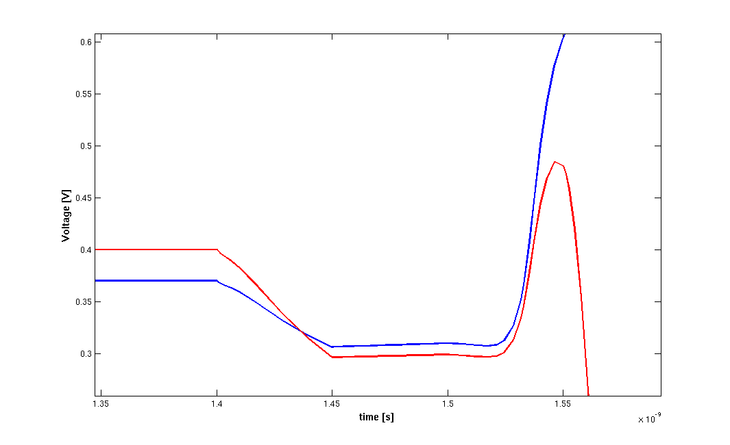
Pass gates turned off
No β variation
latching
nMOS β variation ( )

Slide 9
R
R
CL
Cint
Cint
CL

Slide 10
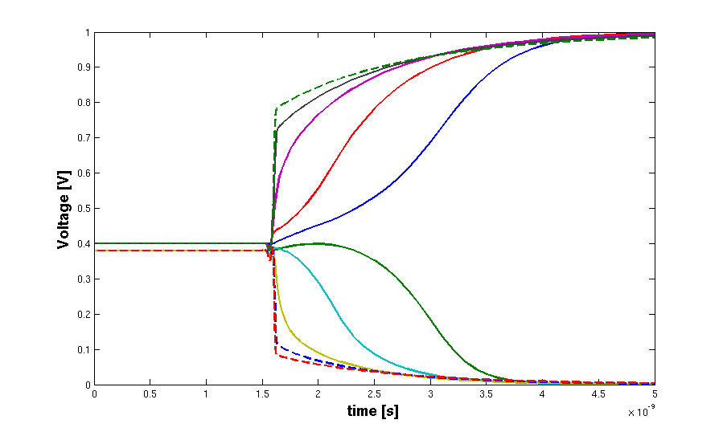
R=0 Ω
R=5 kΩ
R=10 kΩ
R=15 kΩ
R=20 kΩ

Slide 11
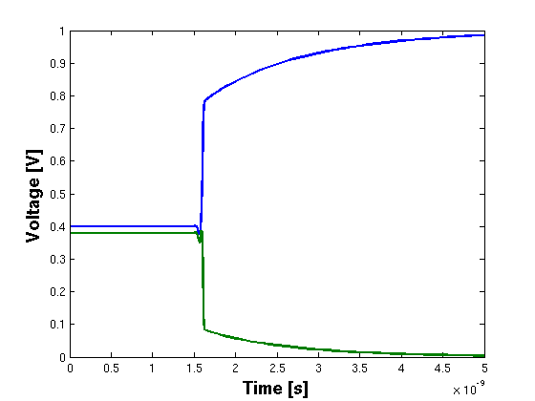
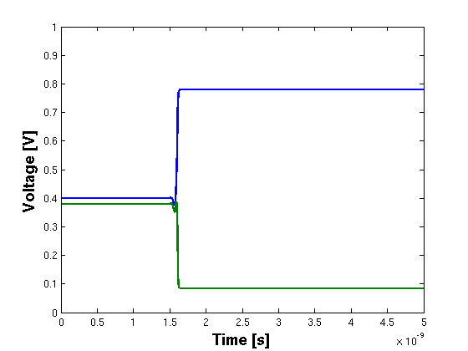
V(t=0)=0.4V
V(t=0)=0.38V
V(t=0)=0.4V
V(t=0)=0.38V
0.4V
+
+
0.38V
-
-

Slide 12
Vcap
V(t) = a t

Slide 13
